Slide 1


CANoe EIB implementation
More Lives Saved
More Life Lived
Implementation: Victor Ursache
Presentation: Agapi Grigore
SWV

Slide 2
Needed files:
1. EIB_Control.cin → Functions for used for EIB configuration
2.1 EIB.sysvar → System variables
2.2 CORE_Functions_SysVar.vsysvar → System variables
3. EIB_StartValues.svc → Used to configure COM port
See also: How to use EIB board Share Point guide (Cannot be opened with test bench generic user; must use normal user).
https://alvteams.alv.autoliv.int/sites/RBEALVEleMech/SW_Verification/Work%20Instructions%20%20How%20To%20Articles/How%20to%20use%20EIB%20Board.aspx
PTC location: e:/MKSProjects/SWVR_PP_CI_Activities/CANOE_TEST_PLATFORM/Includes/HW_Modules/EIB/
Implemented and tested on : CANoe Build 15.4.35 (SP4) – 64 bit

Slide 3
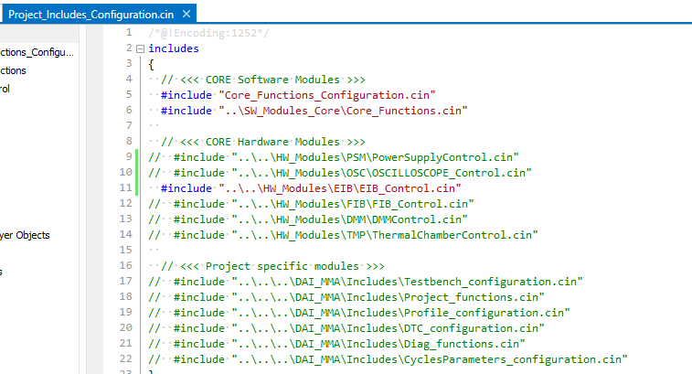
1. EIB.cin
Uncomment the include line from “…\Includes\SW_Modules\SW_Modules_Project\Project_Includes_Configuration.cin”
or include the file to any compatible location if the core structure is not used in your project.

Slide 4
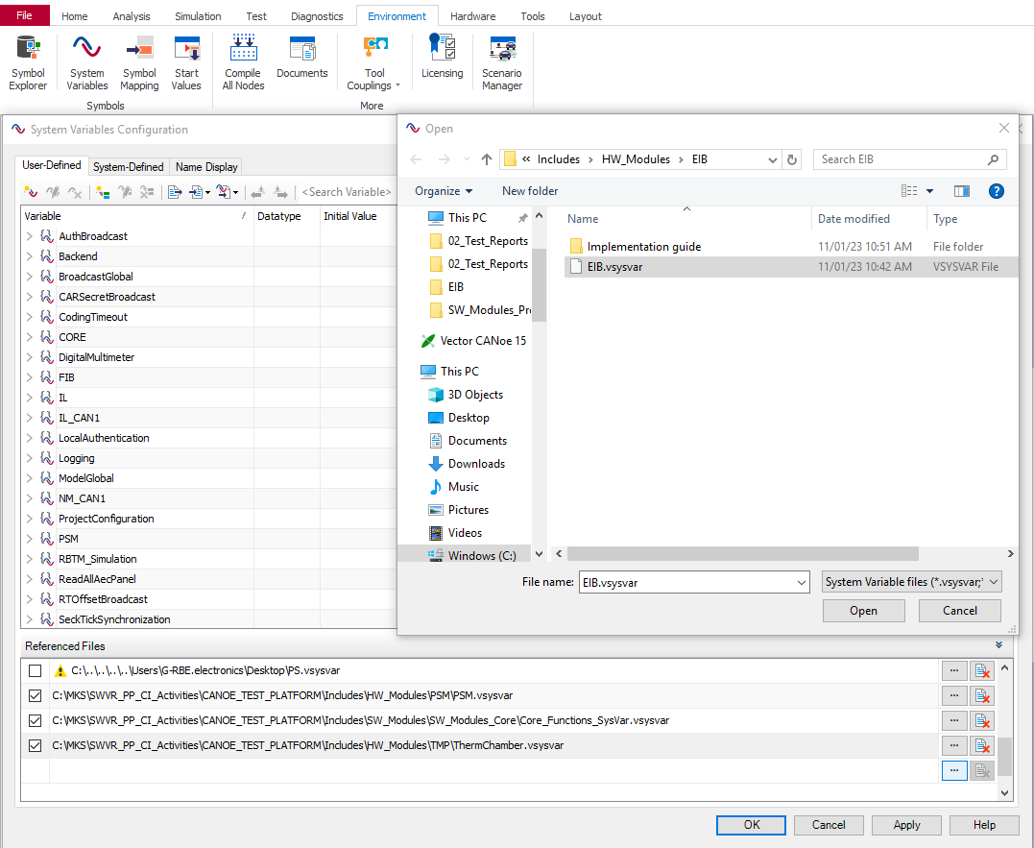
2.1 EIB.vsysvar
Import to CANoe configuration: (1) Environment → (2) System Variables → (3) Select File → (4 & 5) Open
1
2
4
5
3

Slide 5
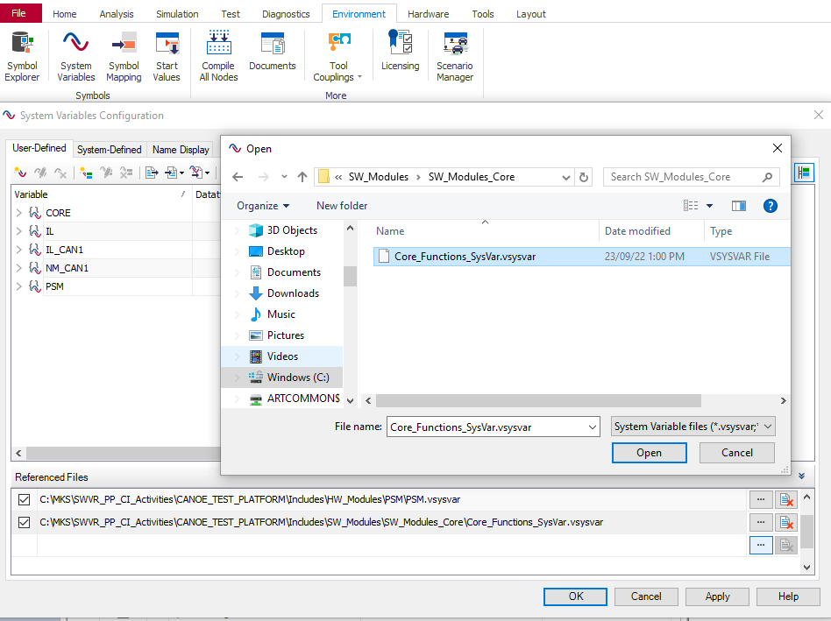
2.2 CORE_Functions_SysVar.vsysvar
Location: e:/MKSProjects/SWVR_PP_CI_Activities/CANOE_TEST_PLATFORM/Includes/SW_Modules/SW_Modules_Core
Import to CANoe configuration: (1) Environment → (2) System Variables → (3) Select File → (4 & 5) Open
1
2
4
5
3

Slide 6
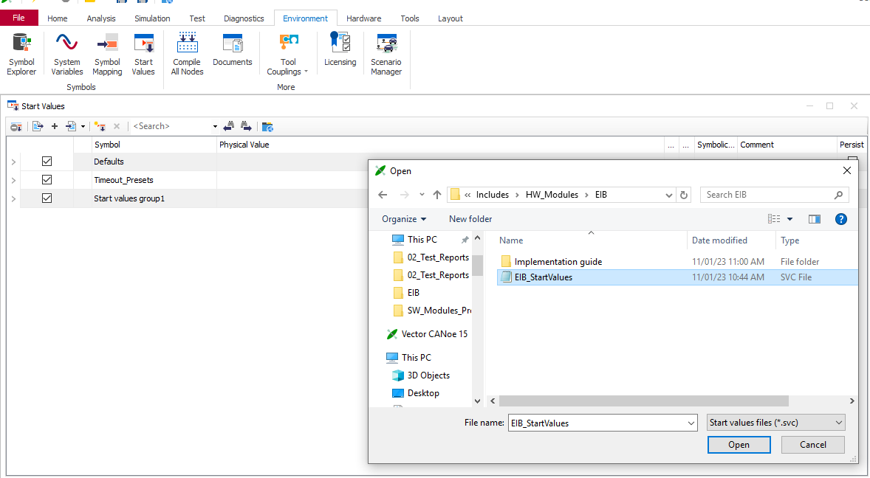
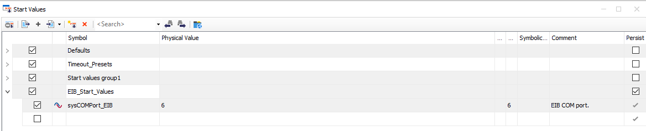
3. EIB_StartValues.svc
Import to CANoe configuration: (1) Environment→ (2) Start Values→ (3) Append (+) → (4) Open EIB_StartValues.svc
IMPORTANT: Save the CANoe configuration before starting the simulation.
The COM port is configured through the ‘Start Values’ panel. Configuration is done before simulation start:
1
2
3
4

Slide 7

Saving More Lives

